Slide 1





Data Visualization: Flowcharts, Graphs, and Graphics
TCOM 600

Slide 2
Agenda
Email feedback
Visual communication
Intro and definition
Types of visualizations
Practice creating a visualization
Flowcharts
Purpose
Principles and characteristics
Practice creating a flowchart
Assignment
Assignment breakdown
Start planning

Slide 3
Agenda as a Flowchart
Email feedback
Visual communication
Intro and definition
Types of visualizations
Practice creating a visualization
BREAK
Flowcharts
Purpose
Principles and characteristics
Practice creating a flowchart
Practice creating a visualization
BREAK
Assignment
Assignment breakdown
Start planning

Slide 4

*Email Feedback
Check the tone:
Is it concise and to the point?
Did you write full sentences?
Did you check grammar and vocabulary?
3 clear parts:
Is the purpose clear?
Are the details easy to read?
Is the expected action clear?

Slide 5
Discussion
What is visual communication?
In what ways is it similar to written communication? In what ways is it different?
Why will you want to use visual communication tools in your future work?
What types of visual communication might you use?

Slide 6
Visual Communication
Visual communication refers to any type of communication that uses visual elements to convey a message.
1
Visual communication helps engage audiences; effective visual communication improves comprehension and retention.
2

Slide 7
Data Visualization
What is a data visualization? Can you think of examples of data visualization?
Why would you want to create data visualizations in your work or technical writing?

Slide 8
Presenting & Sharing Data
Visualizations help us present complex data and numbers.
They clarify data and make numerical information meaningful.
Well constructed visuals make data easier to understand and remember.

Slide 9

Another reason to use visual data?
Readers may be bored or confused by large amounts of text, or non-technical audiences may not understand raw data (large, lengthy spreadsheets)

Slide 10

Basic Types of Visuals
Tables
Bar graphs
Pie charts
Line charts
Flow charts
Maps
Infographics
Dashboards

Slide 11

Small Group Brainstorm (*H/O)
Based on your knowledge and experience, work with your group to brainstorm the objective of the categories of data visualization mentioned above. If you are uncertain of the objective of a type of visualization, that is okay!

Slide 12

Matching Graphics and Objectives
When using visualizations, you need to match the type of visual to your communication objectives.

Slide 13
Tables
Present quantitative information in ordered columns and rows.
Tables present large amounts of data in a systematic way.
Used when exact figures are important.

Slide 14
Bar Charts
Bar charts or column charts are used to make visual comparisons.
They compare related items, show changes over time, of show parts of a whole.
Less focused on exact data/figures; more focused showing visual comparisons.

Slide 15
Pie Charts
Pie charts visualize proportions and parts in relation to the whole.
They are most useful for showing percentages.

Slide 16
Line Charts
Line charts show changes over time. They highlight trends and important points.
They don’t provide exact data; the focus is not on exact data.
Line charts may have one or more variables. With multiple variables they may compare items over time, show frequency or distribution, or show correlations.

Slide 17
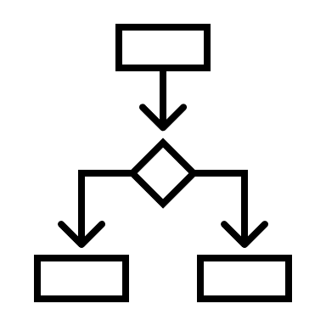
Flowcharts
Flowcharts visually demonstrate processes and procedures.
Flowcharts break down complicated processes in an easy-to-understand way.
Flowcharts use specific shapes and symbols to represent key elements in a process.

Slide 18

Diagrams
Diagrams are a type of illustration that provide instructional information of a specific subject.
Often they identify of a subject and their functional relationship; emphasize detail, or show dimensions.

Slide 19

Infographics
Infographics are longer visual representations of data. They combine a variety of the tools mentioned above to present one key idea or topic using minimal text.
Saskpolytech (2015). Annual Report
https://saskpolytech.ca/about/about-us/reports-and-statistics/annualreport/documents/2015-16-SaskPolytech-Annual-Report.pdf

Slide 20
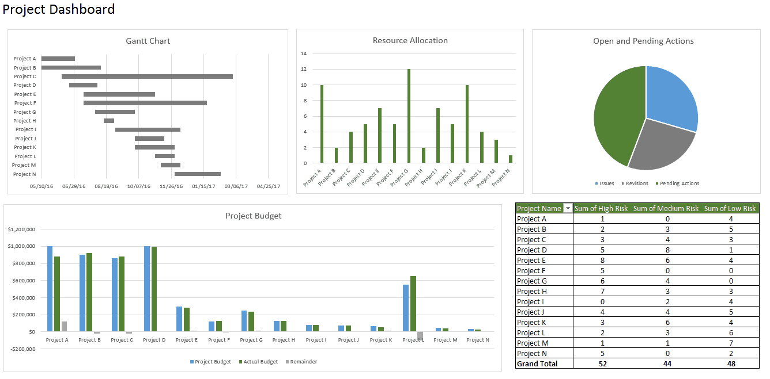
Dashboards
A dashboard contains key performance indicators, metrics, and other data points in one visual central place.
They contain charts, tables, views that are backed by data within the spreadsheet.
*More on this in the next two classes!
Smartsheet (2021) How to create a dashboard in Excel. https://www.smartsheet.com/how-create-dashboard-excel

Slide 21

Discussion
What do you think are the differences between infographics & dashboards?

Slide 22
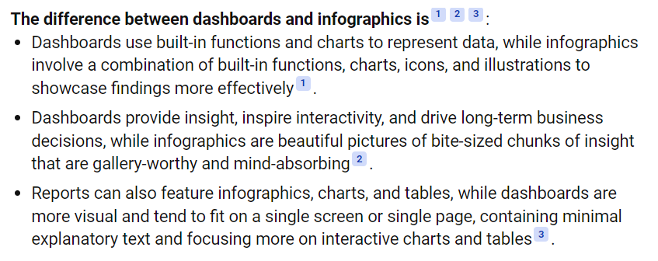
Dashboards vs Infographics

Slide 23

Organization Chart
Organization charts are used in large companies or organizations.
They map the divisions and levels of responsibility or hierarchy within an organization.

Slide 24

Photos
Photos are used to show a subject or topic in detail. Screenshots are often used to emphasize key technical steps.
In technical writing and reports, photos should be used to explain and inform, not decorate a document.

Slide 25
Visualization Tools
MS Word and PPT have basic tools for creating visualizations.
Excel offers far more functions for creating visualizations (we will talk about this more in the next few weeks!)

Slide 26
Quick Activity
Create a simple visualization.
Find the activity on Brightspace: Data Visualization Practice

Slide 27
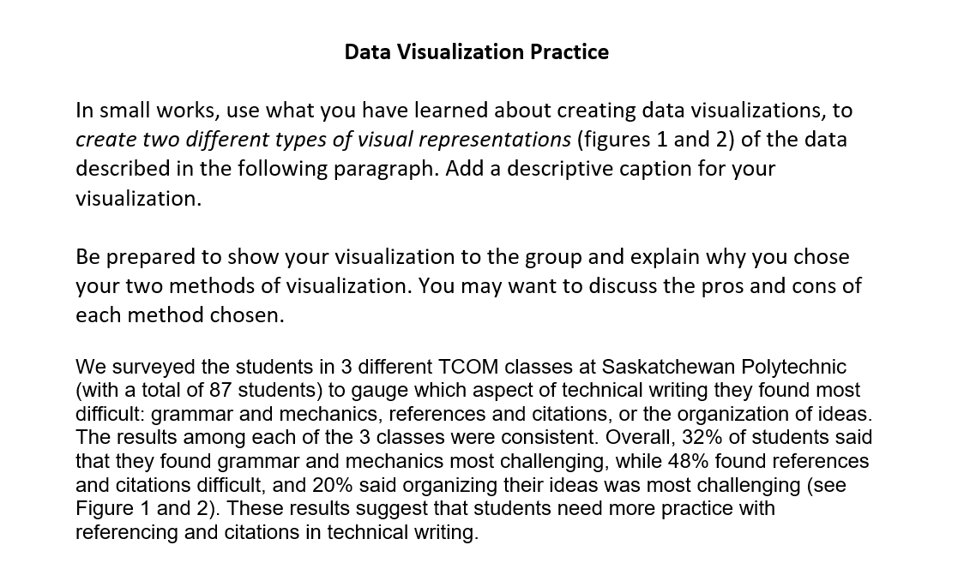
Data Visualization Activity

Slide 28
Data Visualization Activity Tools you can use
PowerPoint / insert / chart (select the type of chart from the list)
Excel

Slide 29
Pie Chart

Slide 30
Bar / Column Chart

